Slide 1
TELECOM DATA ANALYSIS
Insights and Findings from Telecom Usage Data
Prepared By:- Upasna Agrawal

Slide 2
INTRODUCTION
Objective: To analyze telecom usage data to derive insights on user behavior, network performance, and service optimization.
Dataset Overview: The dataaset consists of 150,000 records with 55 features detailing user interactions and metrics
Key Attributes: Bearer ID, Call Duration, Data Usage (YouTube, Netflix), Device Information, Network Type etc.

Slide 3
DATA UPLOAD AND LIBRARIES
Libraries Used: NumPy for numerical operations.
Pandas for data manipulation.
Matplotlib and Seaborn for data visualization.
Sklearn library (short for scikit-learn) is popular libraries in Python for machine learning and data analysis.
Dataset Loading: The dataset was uploaded using Pandas.

Slide 4
USER OVERVIEW ANALYSIS
Top 10 Handsets Used by Customers.-The Huawei B528S-23A is the most common device, with 20,324 occurrences, significantly outnumbering others.
Top 3 Handset Manufacturers. Apple has a significant share (e.g., 40–45%), its strong market presence.
Top 5 Handsets per Top 3 Handset Manufacturer-Main market leaders (e.g., Apple, Samsung, Huawei) are not prominent here. Instead, the focus seems to be on less common manufacturers.
Description of parameter :Throughput: Downlink: Average throughput is 13,300 kbps, but the maximum reaches 378,160 kbps, showing high variability depending on user or network conditions.
Average RTT (Round Trip Time): Downlink: The mean is 109.8 ms, with a maximum of 96,923 ms, indicating occasional severe latency issues. Uplink: The mean is significantly lower at 17.6 ms, suggesting faster acknowledgments in the uplink direction.

Slide 5
USER OVERVIEW ANALYSIS
Description of dataset-The mean and standard deviation provide an understanding of average performance and variation. Minimum, 25th percentile, median, 75th percentile, and maximum values allow for insights into data distribution.
The large variance in some metrics (e.g., Avg RTT DL and Avg Bearer TP DL) might indicate diverse network conditions
Different applications ( Social Media, Google, YouTube) contribute to total data usage-Gaming Consumes the most data, accounting for approximately 61.56 GB. email and social media have a relatively minor impact on overall data consumption
Correlation Analysis : Most correlations are very weak, indicating relatively independent behavior among these categories of data usage. Stronger correlations between uploads and downloads of the same category (e.g., Netflix DL vs Netflix UL) .

Slide 6
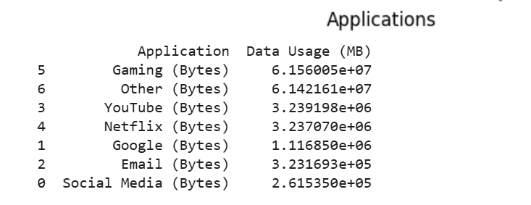
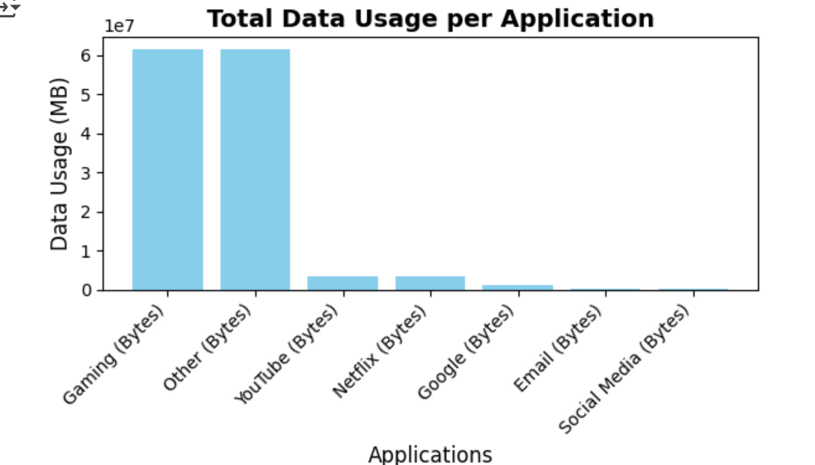
USER OVERVIEW ANALYSIS
Different applications ( Social Media, Google, YouTube) contribute to total data usage-
Gaming Consumes the most data, accounting for approximately 61.56 GB. email and social media have a relatively minor impact on overall data consumption

Slide 7
USER ENGAGEMENT ANALYSIS
Parameter of Engagement Metrics:
• Session s frequency.
• Duration of the session.
• Session total traffic (download and upload in bytes).
Top 10 customers per engagement metrics : we have taken the top 10 user of each parameters.
Normalize each engagement metric using k-means clustering (k=3) to classify.
Elbow method The elbow method is a technique used in K-means clustering to determine the optimal number of clusters (k) in a dataset. WCSS measures the total variance within each cluster. It plots the number of clusters (k) on the x-axis and WCSS on the y-axis.

Slide 8
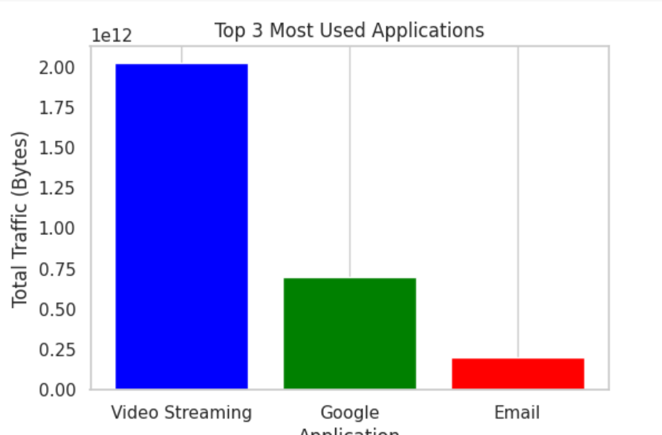
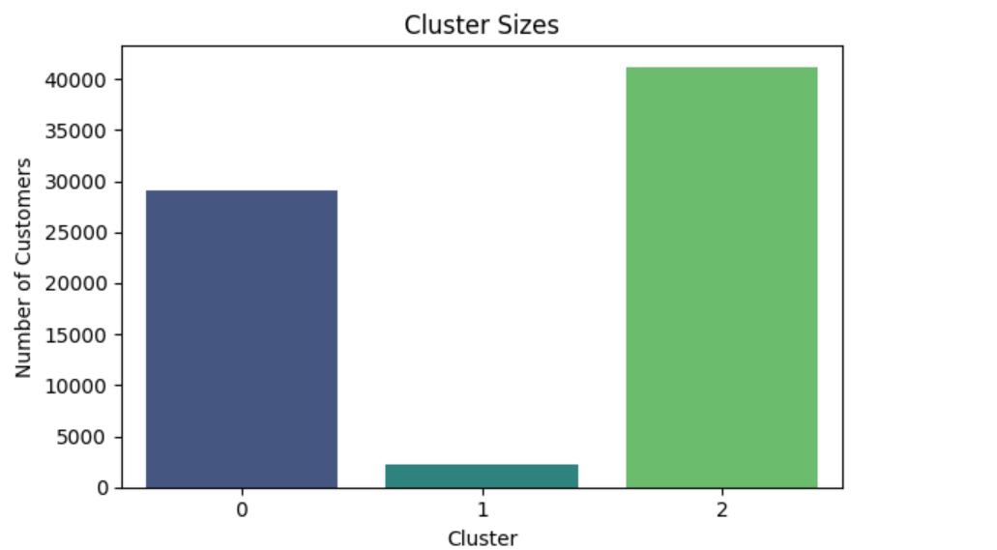
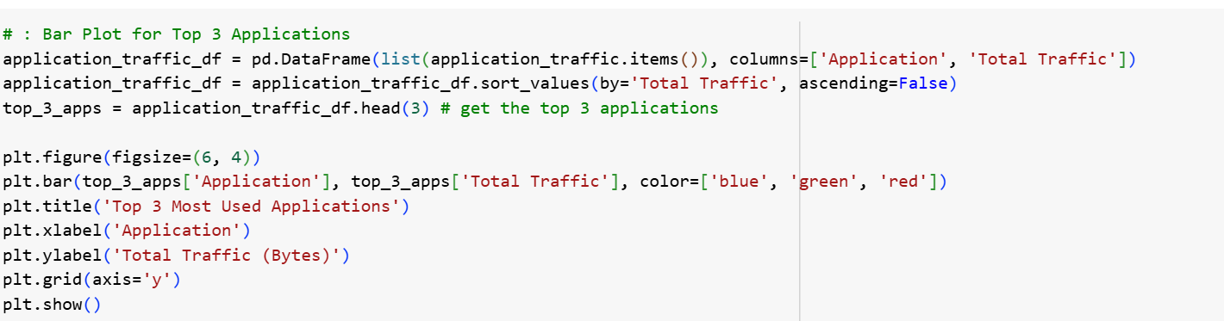
USER ENGAGEMENT ANALYSIS
Cluster -Cluster sizes were Cluster 0 Contains around 30,000 customers . Cluster 1 Is the smallest group, with fewer than 5,000 customers . Cluster 2: Is the largest group, with over 40,000 customers.
Top 3 most used applications which is Video Streaming, Google and Email.

Slide 9
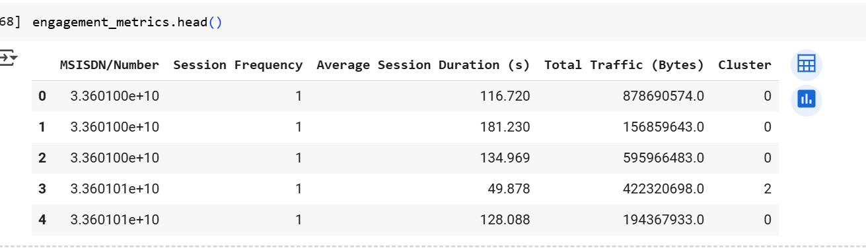
USER ENGAGEMENT ANALYSIS
Engagement metrics data:
Session Frequency: Indicates the number of sessions for each user .
Average Session Duration (s): Shows the average session duration in seconds for each user.
Total Traffic (Bytes): Represents the total data traffic (in bytes) for each user.
Cluster-A clustering label (e.g., 0, 2) potentially derived from a clustering algorithm like K-means.

Slide 10
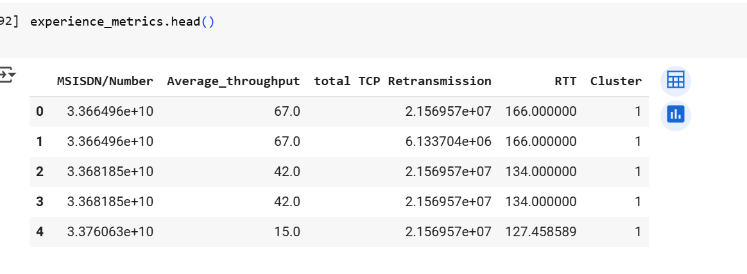
EXPERIENCE ANALYTICS
Network Parameters: TCP retransmission, Round Trip Time (RTT), Throughput.
Total TCP Retransmission: Represents the total number of TCP retransmissions, suggesting network issue.
RTT: Stands for "Round Trip Time," measuring latency or the time taken for a signal to travel to a server and back, expressed in milliseconds.
Average_throughput: Indicates the average network throughput for the user, likely in Mbps or similar units.

Slide 11
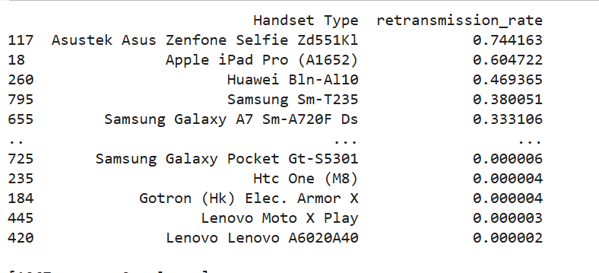
EXPERIENCE ANALYTICS
Take out the top 10 largest RTT, total TCP Retransmission by using n largest .
Find the bottom10 smallest RTT, total TCP Retransmission by using n smallest method .
We have checked the missing value by using isnull().sum()
Average retransmissions per handset type data as below:

Slide 12
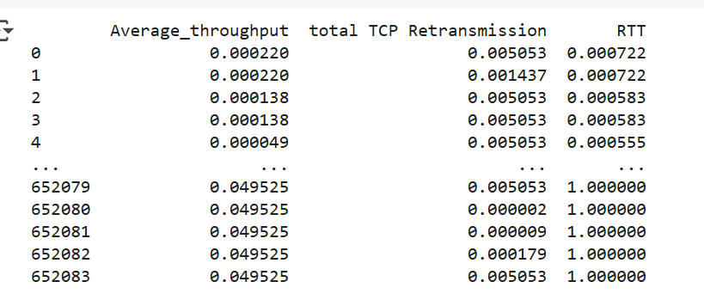
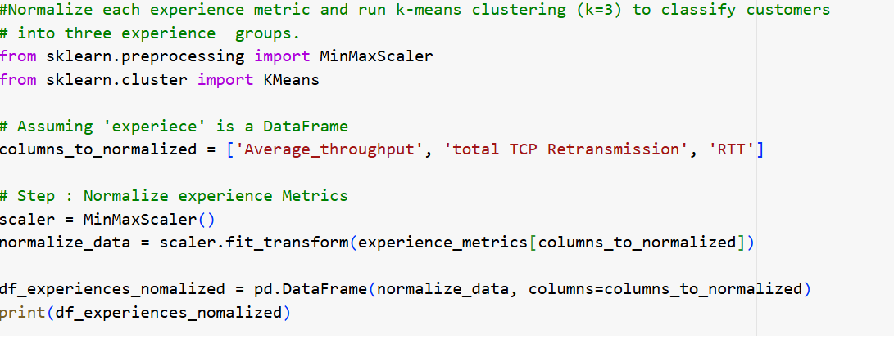
EXPERIENCE ANALYTICS
#Normalize each experience metric and run k-means clustering (k=3) to classify customers.
After the normalized value come between 0 and 1
We Perform k-means clustering (k=3) based on experience metrics.

Slide 13
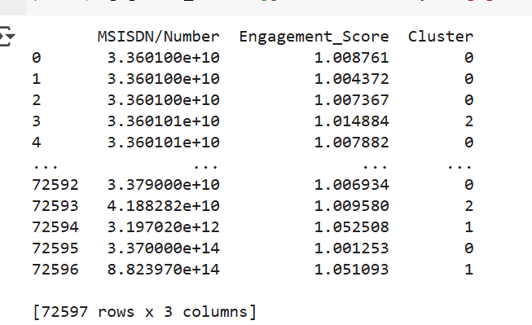
SATISFACTION ANALYSIS
Euclidean distance-Euclidean distance is a measure of the straight-line distance between two points in Euclidean space.
In clustering (e.g., K-means), Euclidean distance is often used to determine the similarity between data points.
Engagement score to each user as the Euclidean distance.

Slide 14
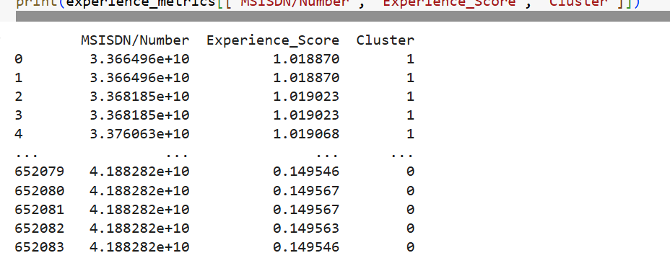
SATISFACTION ANALYSIS
An experience score to each user as the Euclidean distance.

Slide 15
SATISFACTION ANALYSIS
top 10 satisfied customers on Engagement Metric
top_10_satisfied_customers=engagement_metrics.nlargest(10,'Engagement_Score')
top_10_satisfied_customers
top 10 satisfied customers based on Experience Score in experience metrics
top_10_satisfied_customers=experience_metrics.nlargest(10,'Experience_Score')
top_10_satisfied_customers
Satisfaction score-
satisfaction_score=(engagement_metrics['Engagement_Score']+experience_metrics['Experience_Score'])/2
satisfaction_score

Slide 16
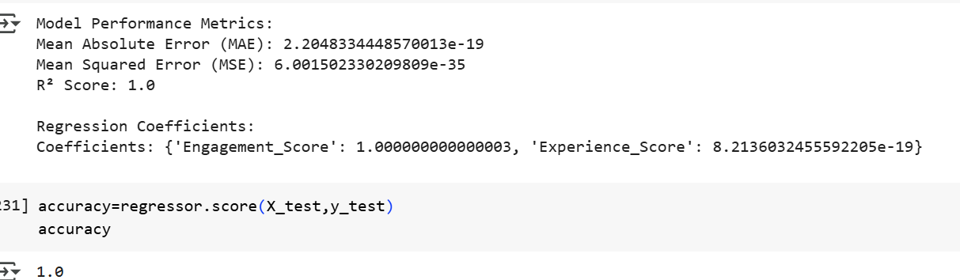
SATISFACTION ANALYSIS
We had split the data in train and test and used the Linear regression model .
We have taken the parameter in X and y axis after the we have done y pred .
We have calculated accuracy score .

Slide 17
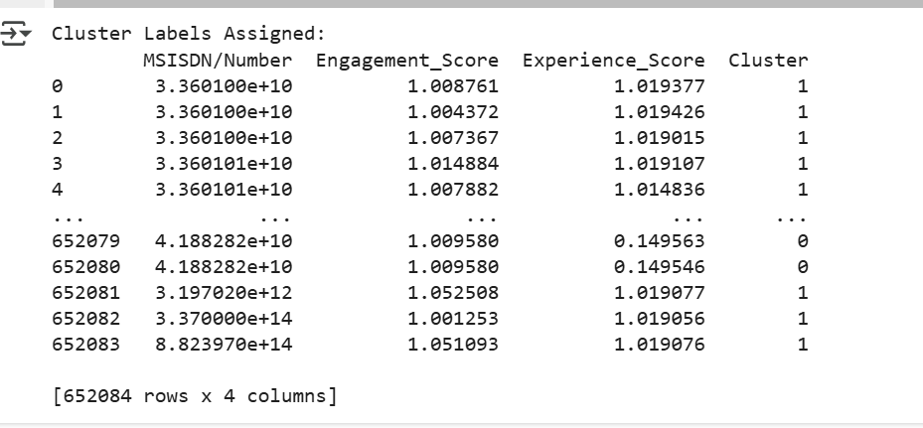
SATISFACTION ANALYSIS
Display cluster assignment:
A computed score that represents the quality of user experience, likely based on network performance metrics such as throughput, RTT, or retransmissions.
A computed score that quantifies user engagement, possibly derived from metrics such as session frequency, session duration, or traffic.
Cluster represents the cluster label assigned to each user after applying a clustering algorithm (e.g., K-means). The values (e.g., 0, 1) indicate the cluster to which each user belongs.

Slide 18
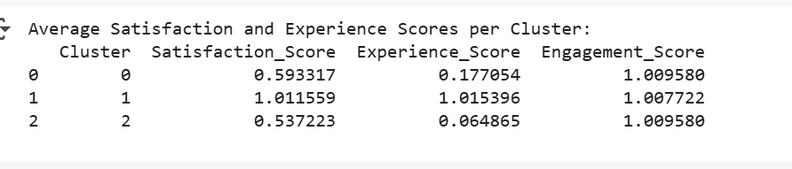
SATISFACTION ANALYSIS
Aggregate Scores per Cluster:
We have calculated the average of engagement and experience scores as the satisfaction score.

Slide 19
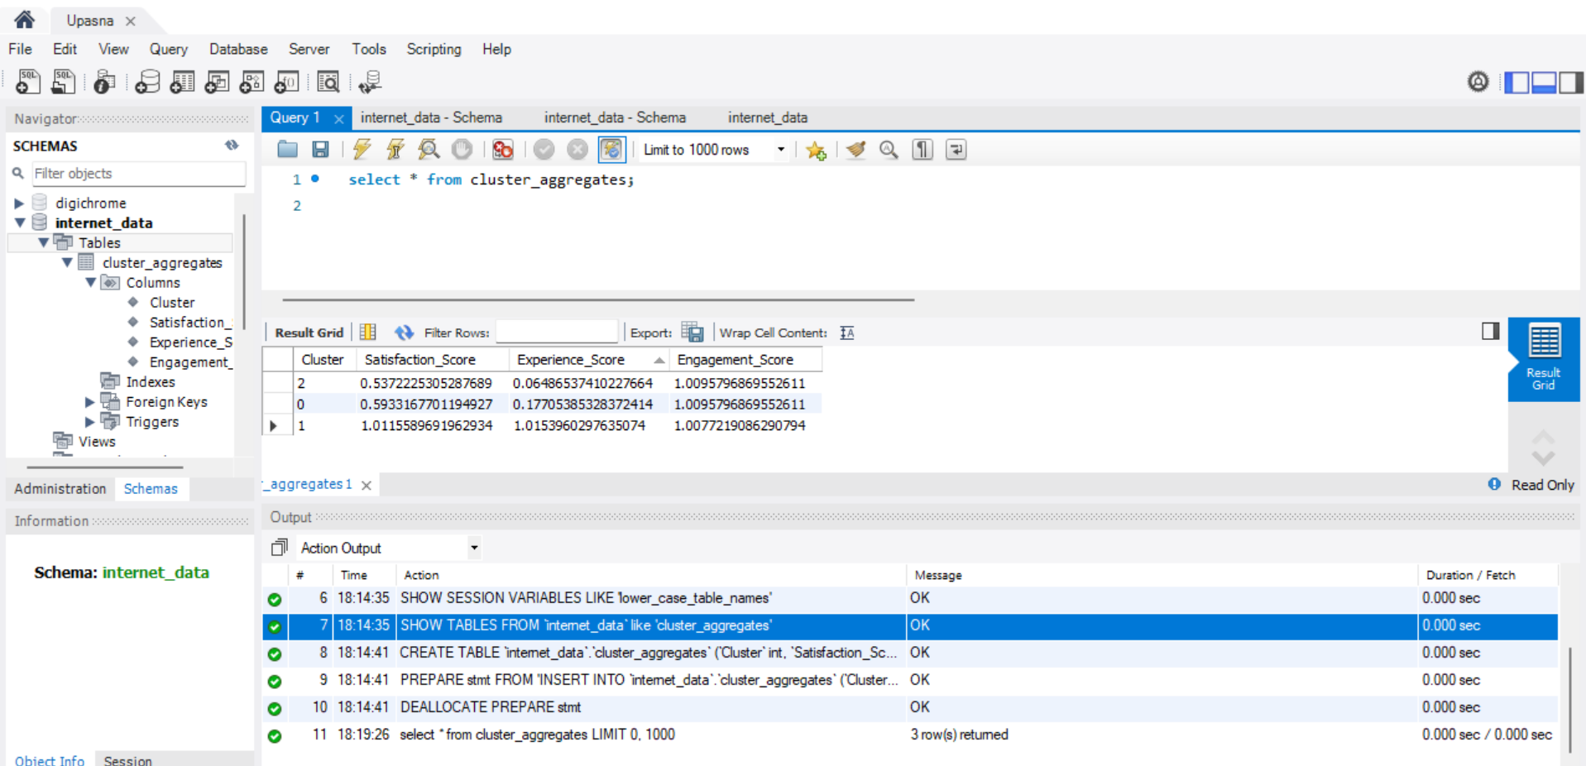
EXPORT DATA IN MYSQL

Slide 20
CONCLUSION OF TELECOM DATA ANALYSIS
The dataset contains extensive records of telecom usage, including metrics such as duration of calls, data usage across various applications (e.g., YouTube, Netflix, gaming), and user device information.
It comprises 150,000 entries with 55 columns detailing user interactions over a specified period.
User Behavior Insights: The analysis also sheds light on user behavior concerning data limits and application usage.
Average Throughput: The average throughput for downloads and uploads was calculated, showing variations based on time of day and user activity.
The analysis of the telecom dataset provides valuable insights into user behavior, device preferences, and performance metrics that can inform strategic decisions for telecom service providers to enhance customer satisfaction and optimize service delivery.

Slide 21
Thank You

